Slide 1
Creation, Creativity and Working Collectively

Slide 2
Creation is both a collective and individual affair.

Slide 3
Creativity is both a collective and individual affair.

Slide 4
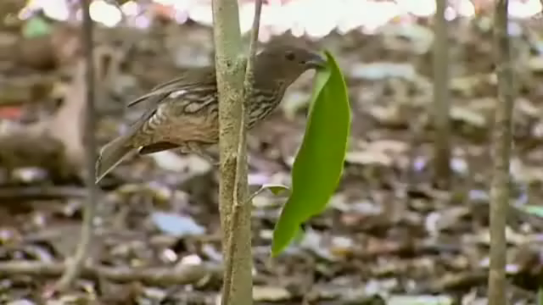
Australian Tooth-Billed Bowerbirds
"Every morning the Scenopoetes dentirostris, a bird of the Australian rain forests, cuts leaves, makes them fall to the ground, and turns them over so that the paler, internal side contrasts with the earth. In this way it constructs a stage for itself like a ready-made; and directly above, on a creeper or a branch, while fluffing out the feathers beneath its beak to reveal their yellow roots, it sings a complex song made up from its own notes and, at intervals, those of other birds that it imitates: it is a complete artist. Gilles Deleuze and Félix Guattari, What is Philosophy?

Slide 5
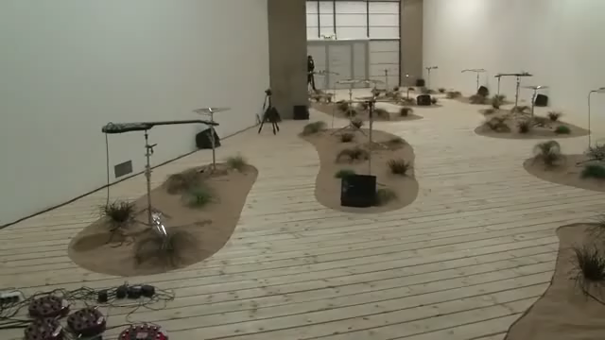
Céleste Boursier-Mougenot: From Here to Ear, an installation of electric guitars and zebra finches at London's Barbican Curve gallery, 23 February – 23 May 2010.

Slide 6
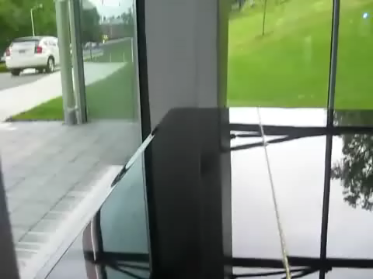
Céleste Boursier-Mougenot: Index (4) 2006-2009
In earlier versions of this project, the text was supplied by computer keyboards in the vicinity: the typing of museum staff, patrons at an internet café, etc. The software was designed to analyse the activity carried out on the computer keyboard, in order to extract from it the elements of a score and transmit them in the form of "Midi code" to an acoustic piano which played them live. For another exhibition, the piano score was a translation of stock market data from business news and financial information websites.

Slide 7
Group projects involving multiple goals and a broader range of participants may be more speculative and unpredictable but they can often bring more varied concepts and more innovative articulations onto the same plane. i.e. They can be highly creative.

Slide 8

Hanna Tuulikki, Away with the Birds, Isle of Canna, 2014.
The artist worked with visual artists, musicians, textile artists, dancers, writers, sound recordists, ornithologists, conservationists and anthropologists to produce “Away with the Birds” a body of work exploring the mimesis of birds in Gaelic song.

Slide 9
In Negotiations, Deleuze describes philosophy, art and science “as separate melodic lines in constant interplay with one another. Such interplay, they say, not only reveals “unexpected convergences” but also suggests that there are always “new implications and new directions” for artists, scientists, philosophers and others to explore.

Slide 10
Riverrun2
Crimen y Castigo

Slide 11
Learning is both a solitary and social affair

Slide 12
Verbal Creativity and Expression

Slide 13
CREATIVITY
Creativity, with regard to verbal language and art, could be described as the process of formation of novel articulations between content and expression within and between these assemblages. And the creativity of a particular expression could be considered its propensity to encourage further atypical expressions and its potential to generate new ‘content-expression’ articulations i.e. its potential to force language into a state of flux and intensity.

